Slide 1


KubeEdge - Introduction
Vittorio Cozzolino & Karthee Sivalingam, Huawei Technologies

Slide 2
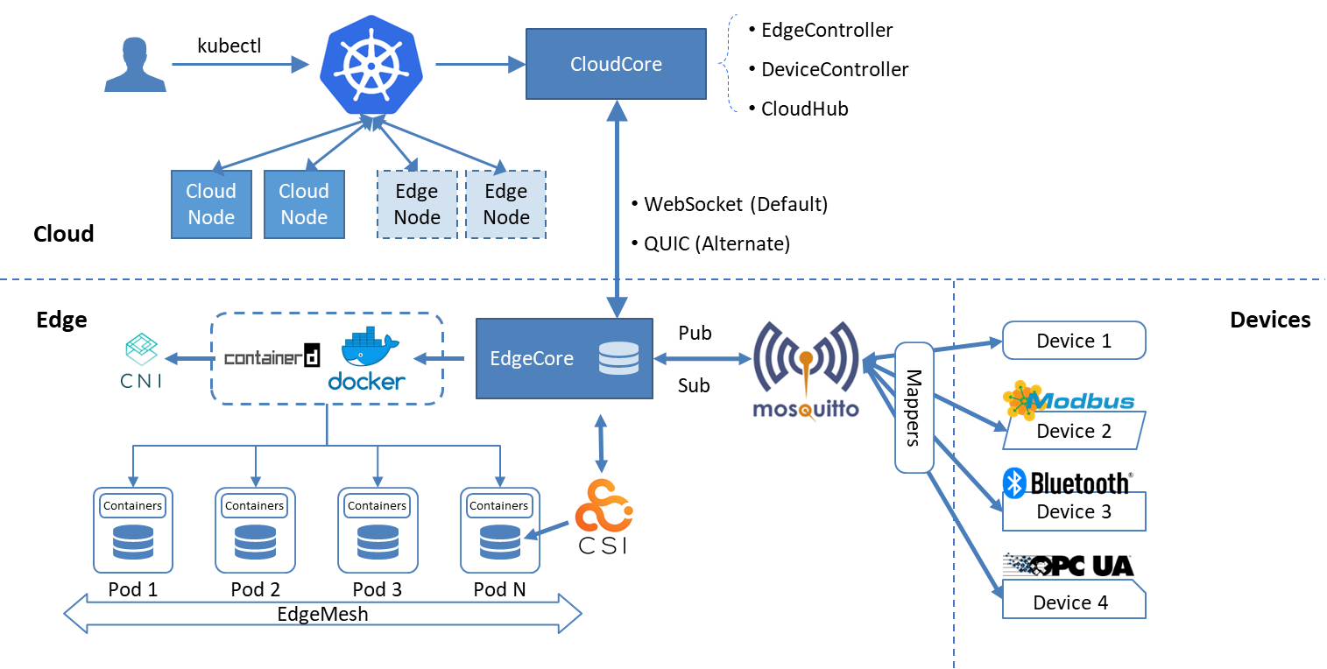
KubeEdge
KubeEdge is built upon Kubernetes and extends native containerized application orchestration and device management to hosts at the Edge.
Key Features
Kubernetes Native API at Edge
Seamless Cloud-Edge Coordination
Edge Autonomy
Low Resource Readiness
Simplified Device Communication
Cloud View of Global Metrics Data

Slide 3

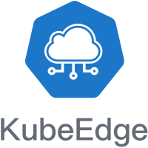
KubeEdge
Advantages
Kubernetes-native support: Managing edge applications and edge devices in the cloud with fully compatible Kubernetes APIs.
Cloud-Edge Reliable Collaboration: Ensure reliable messages delivery without loss over unstable cloud-edge network.
Edge Autonomy: Ensure edge nodes run autonomously and the applications in edge run normally, when the cloud-edge network is unstable or edge is offline and restarted.
Edge Devices Management: Managing edge devices through Kubernetes native APIs implemented by CRD.
Extremely Lightweight Edge Agent: Extremely lightweight Edge Agent(EdgeCore) to run on resource constrained edge.
https://github.com/kubeedge
*Support 100,000 Edge Nodes and manage 1,000,000 pods

Slide 4

KubeEdge
Cloud core
In the Cloud
CloudHub: a web socket server responsible for watching changes at the cloud side, caching and sending messages to EdgeHub.
EdgeController: an extended kubernetes controller which manages edge nodes and pods metadata so that the data can be targeted to a specific edge node.
DeviceController: an extended kubernetes controller which manages devices so that the device metadata/status data can be synced between edge and cloud.
K8S API server
Edge Controller
Device Controller
Cloud Hub
Cloud
Edge

Slide 5
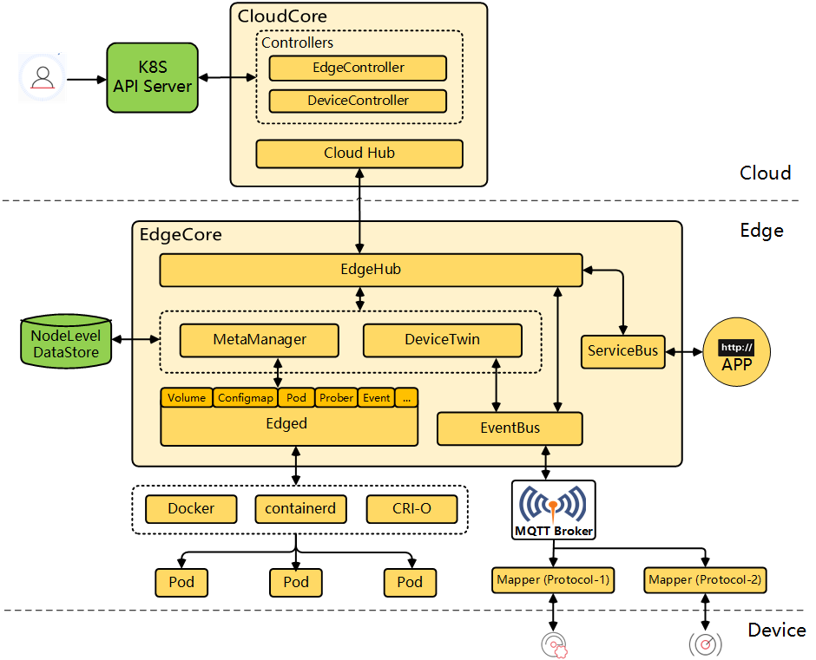
KubeEdge
Cloud core
K8S API server
Edge Controller
Device Controller
Cloud Hub
Cloud
EventBus: a MQTT client to interact with MQTT servers (mosquitto), offering publish and subscribe capabilities to other components.
ServiceBus: an HTTP client to interact with HTTP servers (REST), offering HTTP client capabilities to components of cloud to reach HTTP servers running at edge.
DeviceTwin: responsible for storing device status and syncing device status to the cloud. It also provides query interfaces for applications.
MetaManager: the message processor between edged and edgehub. It is also responsible for storing/retrieving metadata to/from a lightweight database (SQLite).
Edge
EdgeHub: a web socket client responsible for interacting with Cloud Service for the edge computing (like Edge Controller as in the KubeEdge Architecture). This includes syncing cloud-side resource updates to the edge, and reporting edge-side host and device status changes to the cloud.
Edge core
Edge Hub
http:
APP
Meta Manager
Device Twin
Service Bus
Edged
Event Bus
Edged: an agent that runs on edge nodes and manages containerized applications.

Slide 6
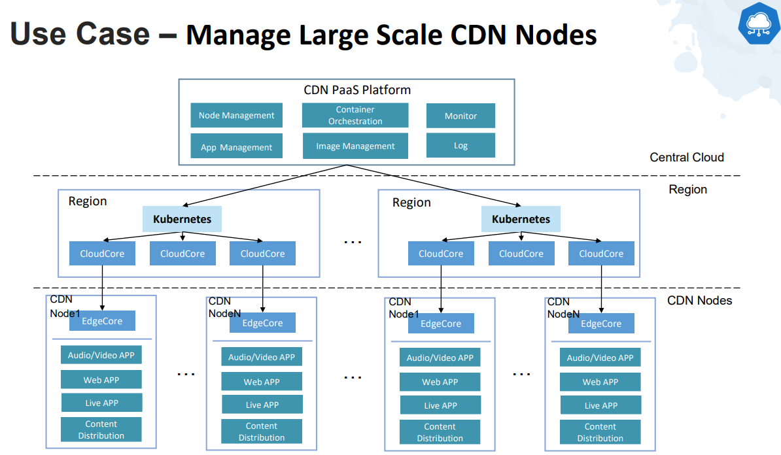
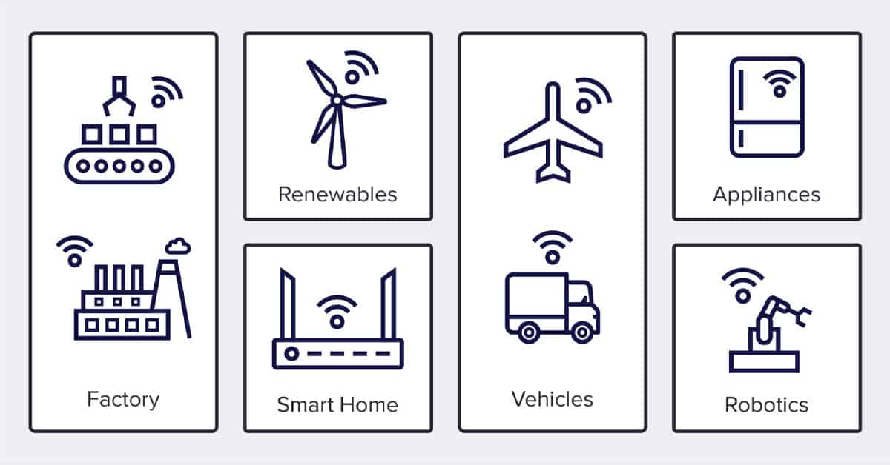
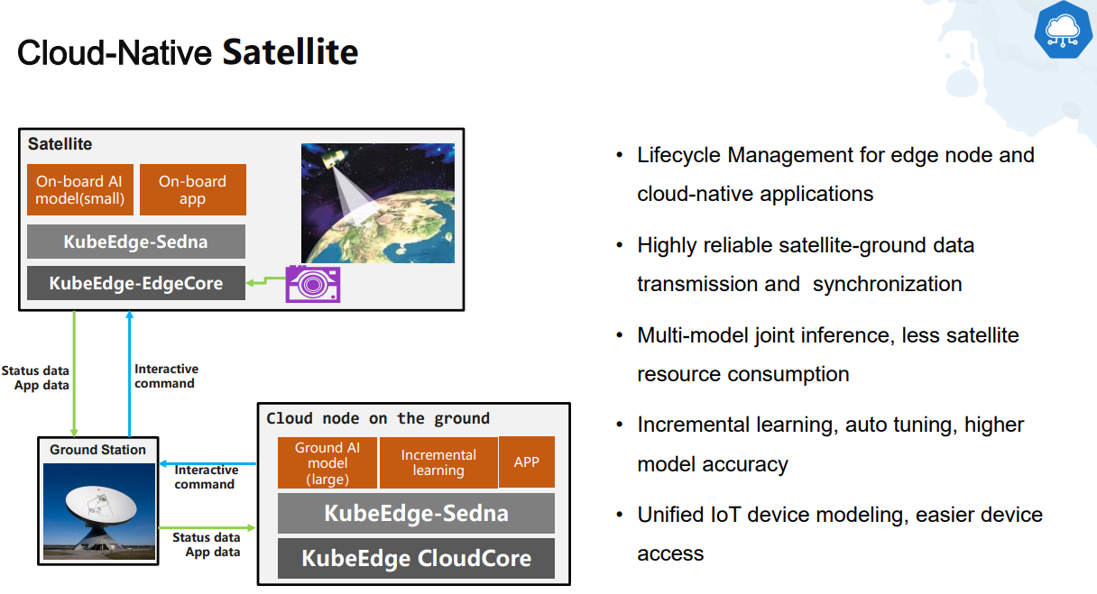
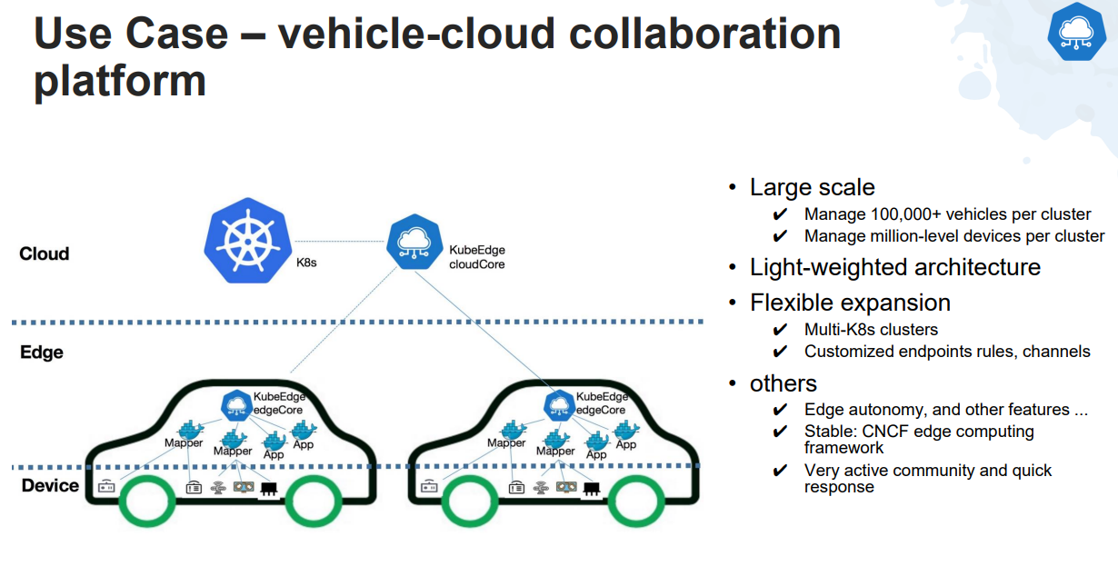
KubeEdge – use cases

Slide 7
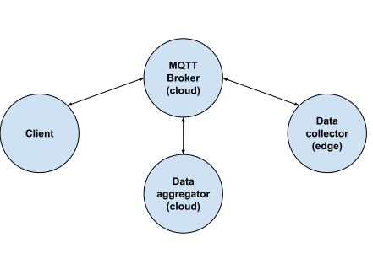
MQTT Data Aggregation and Collection at the Edge
Goal: Deploy on the cluster a MQTT data aggregator (cloud), a data collector (edge) and client (check figure).
Follow the instructions in hands-on to complete the deployment

